Slide 1
Object-Oriented and
Classical Software Engineering
8th Edition, WCB/McGraw-Hill, 2010
Stephen R. Schach srs@vuse.vanderbilt.edu

Slide 2
CHAPTER 3
SOFTWARE
PROCESS

Slide 3
Overview
The Unified Process
Iteration and incrementation within the object-oriented paradigm
The requirements workflow
The analysis workflow
The design workflow
The implementation workflow
The test workflow

Slide 4
Overview (contd)
Postdelivery maintenance
Retirement
The phases of the Unified Process
One- versus two-dimensional life-cycle models
Improving the software process
Capability maturity models
Other software process improvement initiatives
Costs and benefits of software process improvement

Slide 5
3.3 The Requirements Workflow
The aim of the requirements workflow
  To determine the client’s needs

Slide 6
Overview of the Requirements Workflow
First, gain an understanding of the application domain (or domain, for short)
  That is, the specific business environment in which the software product is to operate
Second, build a business model
  Use UML to describe the client’s business processes
  If at any time the client does not feel that the cost is justified, development terminates immediately

Slide 7
Overview of the Requirements Workflow (contd)
It is vital to determine the client’s constraints
  Deadline
    Nowadays, software products are often mission critical
  Parallel running
  Portability
  Reliability
  Rapid response time
  Cost
    The client will rarely inform the developer how much money is available
    A bidding procedure is used instead

Slide 8
Overview of the Requirements Workflow (contd)
The aim of this concept exploration is to determine
  What the client needs
  Not what the client wants

Slide 9
The Analysis Workflow
The aim of the analysis workflow
  To analyze and refine the requirements
Why not do this during the requirements workflow?
  The requirements artifacts must be totally comprehensible by the client
The artifacts of the requirements workflow must therefore be expressed in a natural (human) language
  All natural languages are imprecise

Slide 10
The Analysis Workflow (contd)
Two separate workflows are needed
  The requirements artifacts must be expressed in the language of the client
  The analysis artifacts must be precise, and complete enough for the designers

Slide 11
The Specification Document (contd)
Specification document (“specifications”)
  It constitutes a contract
  It must not have imprecise phrases like “optimal,” or “98% complete”
Having complete and correct specifications is essential for
  Testing and
  Maintenance

Slide 12
The Specification Document (contd)
The specification document must not have
  Contradictions
  Omissions
  Incompleteness

Slide 13
Software Project Management Plan
Once the client has signed off the specifications, detailed planning and estimating begins
We draw up the software project management plan, including
  Cost estimate
  Duration estimate
  Deliverables
  Milestones
  Budget
This is the earliest possible time for the SPMP

Slide 14
The Design Workflow
The aim of the design workflow is to refine the analysis workflow until the material is in a form that can be implemented by the programmers
  Many nonfunctional requirements need to be finalized at this time, including
    Choice of programming language
    Reuse issues
    Portability issues

Slide 15
Object-Oriented Design
Classes are extracted during the object-oriented analysis workflow and
  Designed during the design workflow
Accordingly
  Classical architectural design corresponds to part of the object-oriented analysis workflow
  Classical detailed design corresponds to part of the object-oriented design workflow

Slide 16
The Design Workflow (contd)
Retain design decisions
  For when a dead-end is reached
  To prevent the maintenance team reinventing the wheel

Slide 17
The Implementation Workflow
The aim of the implementation workflow is to implement the target software product in the selected implementation language
  A large software product is partitioned into subsystems
  The subsystems consist of components or code artifacts

Slide 18
The Test Workflow
The test workflow is the responsibility of
  Every developer and maintainer, and
  The quality assurance group
Traceability of artifacts is an important requirement for successful testing

Slide 19
Requirements Artifacts
Every item in the analysis artifacts must be traceable to an item in the requirements artifacts
  Similarly for the design and implementation artifacts

Slide 20
Analysis Artifacts
The analysis artifacts should be checked by means of a review
  Representatives of the client and analysis team must be present
The SPMP must be similarly checked
  Pay special attention to the cost and duration estimates

Slide 21
3.7.3 Design Artifacts
Design reviews are essential
  A client representative is not usually present

Slide 22
3.7.4 Implementation Artifacts
Each component is tested as soon as it has been implemented
  Unit testing
At the end of each iteration, the completed components are combined and tested
  Integration testing
When the product appears to be complete, it is tested as a whole
  Product testing
Once the completed product has been installed on the client’s computer, the client tests it
  Acceptance testing

Slide 23
Implementation Artifacts (contd)
COTS software is released for testing by prospective clients
  Alpha release
  Beta release
There are advantages and disadvantages to being an alpha or beta release site

Slide 24
Postdelivery Maintenance
Postdelivery maintenance is an essential component of software development
  More money is spent on postdelivery maintenance than on all other activities combined
Problems can be caused by
  Lack of documentation of all kinds

Slide 25
Postdelivery Maintenance (contd)
Two types of testing are needed
  Testing the changes made during postdelivery maintenance
  Regression testing
All previous test cases (and their expected outcomes) need to be retained

Slide 26
Retirement
Software can be unmaintainable because
  A drastic change in design has occurred
  The product must be implemented on a totally new hardware/operating system
  Documentation is missing or inaccurate
  Hardware is to be changed — it may be cheaper to rewrite the software from scratch than to modify it
These are instances of maintenance (rewriting of existing software)

Slide 27
Retirement (contd)
True retirement is a rare event
It occurs when the client organization no longer needs the functionality provided by the product

Slide 28
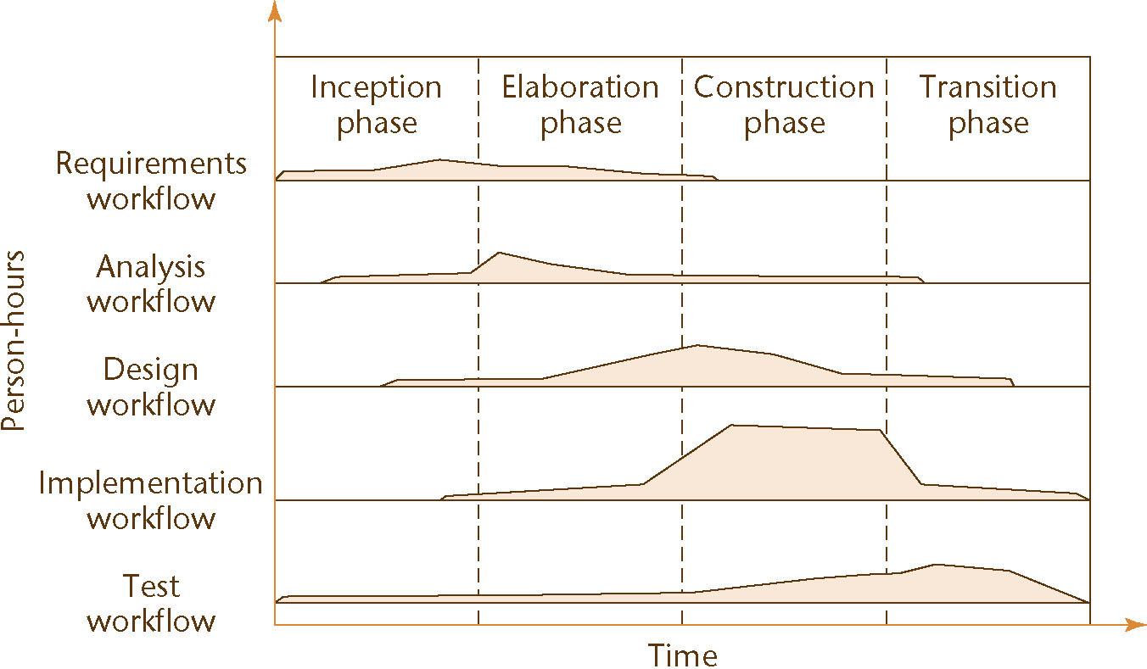
The Phases of the Unified Process
The increments are identified as phases
Figure 3.1

Slide 29
The Phases of the Unified Process (contd)
The four increments are labeled
  Inception phase
  Elaboration phase
  Construction phase
  Transition phase
The phases of the Unified Process are the increments

Slide 30
The Phases of the Unified Process (contd)
In theory, there could be any number of increments
  In practice, development seems to consist of four increments
Every step performed in the Unified Process falls into
  One of the five core workflows and also
  One of the four phases
Why does each step have to be considered twice?

Slide 31
The Phases of the Unified Process (contd)
Workflow
  Technical context of a step
Phase
  Business context of a step

Slide 32
The Inception Phase
The aim of the inception phase is to determine whether the proposed software product is economically viable

Slide 33
The Inception Phase (contd)
1. Gain an understanding of the domain
2. Build the business model
3. Delimit the scope of the proposed project
  Focus on the subset of the business model that is covered by the proposed software product
4. Begin to make the initial business case

Slide 34
The Inception Phase : The Initial Business Case
Questions that need to be answered include:
  Is the proposed software product cost effective?
  How long will it take to obtain a return on investment?
  Alternatively, what will be the cost if the company decides not to develop the proposed software product?
  If the software product is to be sold in the marketplace, have the necessary marketing studies been performed?
  Can the proposed software product be delivered in time?
  If the software product is to be developed to support the client organization’s own activities, what will be the impact if the proposed software product is delivered late?

Slide 35
The Inception Phase: The Initial Business Case
What are the risks involved in developing the software product
How can these risks be mitigated?
  Does the team who will develop the proposed software product have the necessary experience?
  Is new hardware needed for this software product?
  If so, is there a risk that it will not be delivered in time?
  If so, is there a way to mitigate that risk, perhaps by ordering back-up hardware from another supplier?
  Are software tools (Chapter 5) needed?
  Are they currently available?
  Do they have all the necessary functionality?

Slide 36
The Inception Phase: The Initial Business Case
Answers are needed by the end of the inception phase so that the initial business case can be made

Slide 37
The Inception Phase: Risks
There are three major risk categories:
  Technical risks
    See earlier slide
  The risk of not getting the requirements right
    Mitigated by performing the requirements workflow correctly
  The risk of not getting the architecture right
    The architecture may not be sufficiently robust

Slide 38
The Inception Phase: Risks
To mitigate all three classes of risks
  The risks need to be ranked so that the critical risks are mitigated first
This concludes the steps of the inception phase that fall under the requirements workflow

Slide 39
The Inception Phase: Analysis, Design Workflows
A small amount of the analysis workflow may be performed during the inception phase
  Information needed for the design of the architecture is extracted
Accordingly, a small amount of the design workflow may be performed, too

Slide 40
The Inception Phase: Implementation Workflow
Coding is generally not performed during the inception phase
However, a proof-of-concept prototype is sometimes build to test the feasibility of constructing part of the software product

Slide 41
The Inception Phase: Test Workflow
The test workflow commences almost at the start of the inception phase
  The aim is to ensure that the requirements have been accurately determined

Slide 42
The Inception Phase: Planning
There is insufficient information at the beginning of the inception phase to plan the entire development
  The only planning that is done at the start of the project is the planning for the inception phase itself
For the same reason, the only planning that can be done at the end of the inception phase is the plan for just the next phase, the elaboration phase

Slide 43
The Inception Phase: Documentation
The deliverables of the inception phase include:
  The initial version of the domain model
  The initial version of the business model
  The initial version of the requirements artifacts
  A preliminary version of the analysis artifacts
  A preliminary version of the architecture
  The initial list of risks
  The initial ordering of the use cases (Chapter 10)
  The plan for the elaboration phase
  The initial version of the business case

Slide 44
The Inception Phase: The Initial Business Case
Obtaining the initial version of the business case is the overall aim of the inception phase
This initial version incorporates
  A description of the scope of the software product
  Financial details
  If the proposed software product is to be marketed, the business case will also include
    Revenue projections, market estimates, initial cost estimates
  If the software product is to be used in-house, the business case will include
    The initial cost–benefit analysis

Slide 45
Elaboration Phase
The aim of the elaboration phase is to refine the initial requirements
  Refine the architecture
  Monitor the risks and refine their priorities
  Refine the business case
  Produce the project management plan
The major activities of the elaboration phase are refinements or elaborations of the previous phase

Slide 46
The Tasks of the Elaboration Phase
The tasks of the elaboration phase correspond to:
  All but completing the requirements workflow
  Performing virtually the entire analysis workflow
  Starting the design of the architecture

Slide 47
The Elaboration Phase: Documentation
The deliverables of the elaboration phase include:
  The completed domain model
  The completed business model
  The completed requirements artifacts
  The completed analysis artifacts
  An updated version of the architecture
  An updated list of risks
  The project management plan (for the rest of the project)
  The completed business case

Slide 48
Construction Phase
The aim of the construction phase is to produce the first operational-quality version of the software product
  This is sometimes called the beta release

Slide 49
The Tasks of the Construction Phase
The emphasis in this phase is on
  Implementation and
  Testing
    Unit testing of modules
    Integration testing of subsystems
    Product testing of the overall system

Slide 50
The Construction Phase: Documentation
The deliverables of the construction phase include:
  The initial user manual and other manuals, as appropriate
  All the artifacts (beta release versions)
  The completed architecture
  The updated risk list
  The project management plan (for the remainder of the project)
  If necessary, the updated business case

Slide 51
The Transition Phase
The aim of the transition phase is to ensure that the client’s requirements have indeed been met
  Faults in the software product are corrected
  All the manuals are completed
  Attempts are made to discover any previously unidentified risks
This phase is driven by feedback from the site(s) at which the beta release has been installed

Slide 52
The Transition Phase: Documentation
The deliverables of the transition phase include:
  All the artifacts (final versions)
  The completed manuals

Slide 53
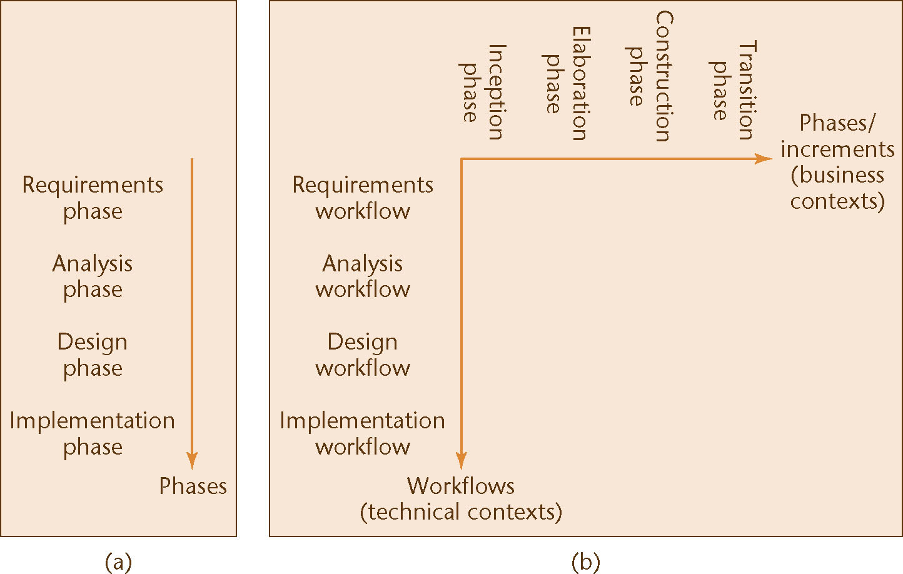
One- and Two-Dimensional Life-Cycle Models
Figure 3.2

Slide 54
Why a Two-Dimensional Model?
A traditional life cycle is a one-dimensional model
  Represented by the single axis on the previous slide
    Example: Waterfall model
The Unified Process is a two-dimensional model
  Represented by the two axes on the previous slide
The two-dimensional figure shows
  The workflows (technical contexts) and
  The phases (business contexts)

Slide 55
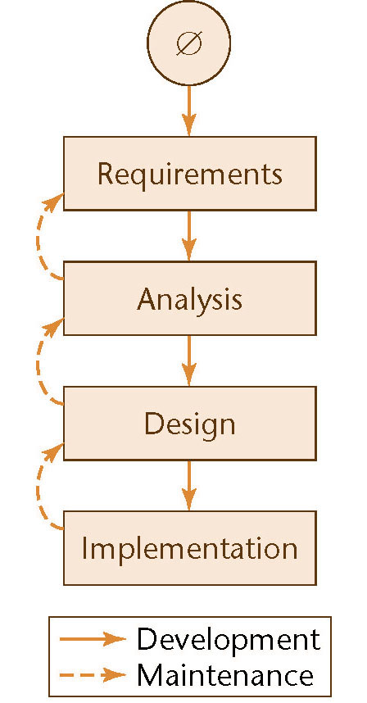
Why a Two-Dimensional Model? (contd)
The waterfall model
One-dimensional
Figure 2.3 (again)

Slide 56
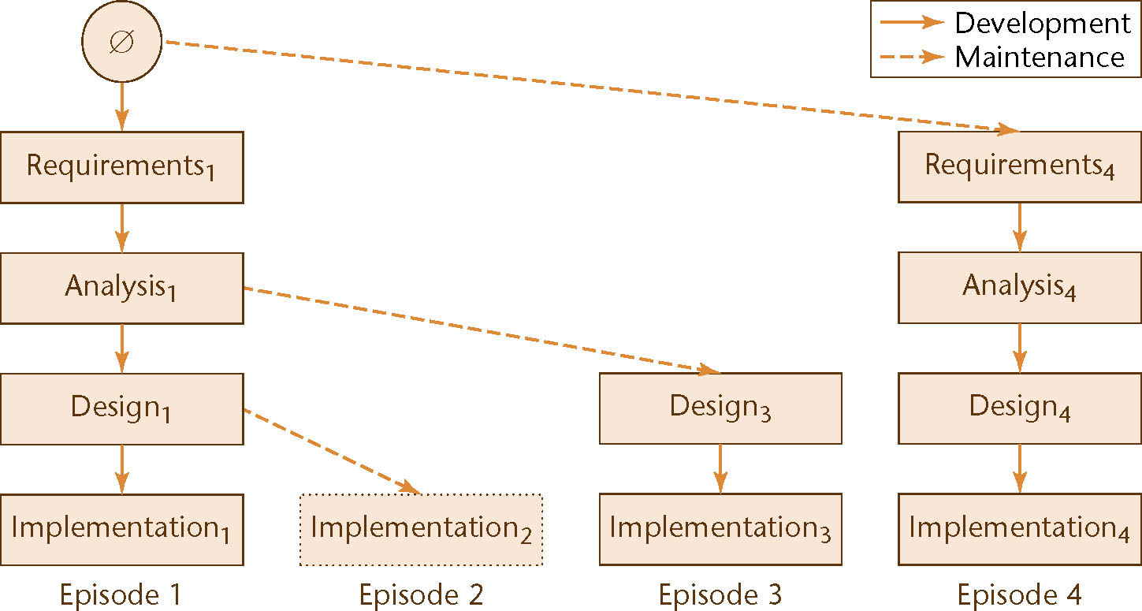
Why a Two-Dimensional Model? (contd)
Evolution tree model
Two-dimensional
Figure 2.2 (again)

Slide 57
Capability Maturity Models
Not life-cycle models
Rather, a set of strategies for improving the software process
  SW–CMM for software
  P–CMM for human resources (“people”)
  SE–CMM for systems engineering
  IPD–CMM for integrated product development
  SA–CMM for software acquisition
These strategies are unified into CMMI (capability maturity model integration)

Slide 58
SW–CMM
A strategy for improving the software process
Put forward in 1986 by the SEI
Fundamental ideas:
  Improving the software process leads to
    Improved software quality
    Delivery on time, within budget
  Improved management leads to
    Improved techniques

Slide 59
SW–CMM (contd)
Five levels of maturity are defined
  Maturity is a measure of the goodness of the process itself
An organization advances stepwise from level to level

Slide 60
Level 1. Initial Level
Ad hoc approach
  The entire process is unpredictable
  Management consists of responses to crises
Most organizations world-wide are at level 1

Slide 61
Level 2. Repeatable Level
Basic software management
  Management decisions should be made on the basis of previous experience with similar products
  Measurements (“metrics”) are made
  These can be used for making cost and duration predictions in the next project
  Problems are identified, immediate corrective action is taken

Slide 62
Level 3. Defined Level
The software process is fully documented
  Managerial and technical aspects are clearly defined
  Continual efforts are made to improve quality and productivity
  Reviews are performed to improve software quality
  CASE environments are applicable now (and not at levels 1 or 2)

Slide 63
Level 4. Managed Level
Quality and productivity goals are set for each project
  Quality and productivity are continually monitored
  Statistical quality controls are in place

Slide 64
Level 5. Optimizing Level
Continuous process improvement
  Statistical quality and process controls
  Feedback of knowledge from each project to the next

Slide 65
Experiences with SW–CMM
It takes:
  3 to 5 years to get from level 1 to level 2
  1.5 to 3 years from level 2 to level 3
  SEI questionnaires highlight shortcomings, suggest ways to improve the process

